Slide 1

ELECTRICAL VEHICLE TECHNOLOGY

Slide 2
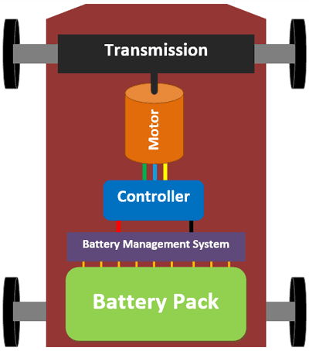
Understanding the EV Components Introduction
Understanding the components of an electric vehicle is crucial to grasp the integral roles played by various parts such as the battery, electric motor, and power electronics. This knowledge is fundamental for comprehending the functioning of an electric vehicle.

Slide 3
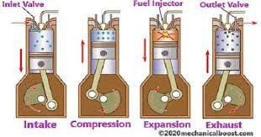
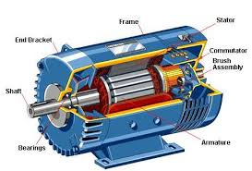
IC Engine Vs Electrical Motors
Internal Combustion Engine
Electrical Motors
Uses fossil fuels, emits pollutants.
Powered by electricity, no direct emissions.

Slide 4
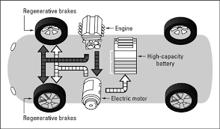
Hybrid Powertrain Technology
Combines IC Engine & Electric Motors
Utilizes the advantages of both power sources.
Efficient Energy Conversion
Maximizes fuel economy and reduces emissions.
Regenerative Braking
Captures kinetic energy to recharge the battery.

Slide 5
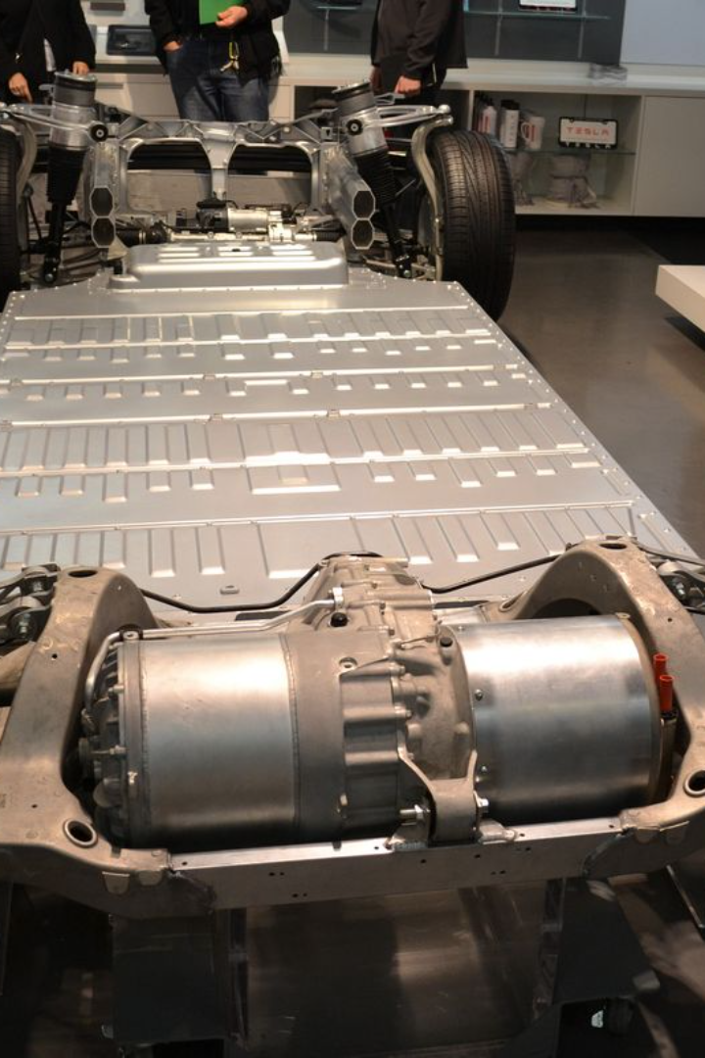
Electric Motor Requirements for EV's
High Torque
Electric motors for EV's need to deliver high torque to ensure quick acceleration and efficient performance.
Power Density
The electric motor should have a high-power density, allowing it to provide more power in a compact size.
Efficiency
An efficient electric motor helps maximize the range of the EV and reduces energy consumption.

Slide 6
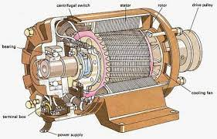
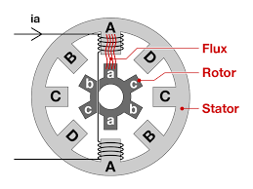
Applications of Induction and Switched Reluctance Motor
Induction Motors
Induction motors are widely used in various industrial and commercial applications, including pumps, compressors, fans, conveyors, and machine tools. They are suitable for both constant and variable speed applications.
Switched Reluctance Motors
Switched reluctance motors find applications in various industries, including automotive, industrial automation, aerospace, and renewable energy. They are often used in applications requiring high torque at low speeds, such as pumps, fans, compressors, and electric vehicles.

Slide 7
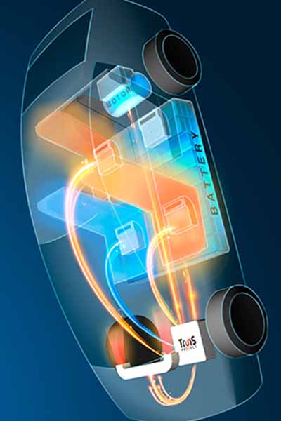
Thermal Management of EV Motors
1
Heat Dissipation
Electric motors generate heat during operation due to electrical losses, mechanical friction, and magnetic losses. The amount of heat generated depends on factors such as motor design, operating conditions, load, and speed.
2
Cooling Systems
Various cooling systems are employed to dissipate heat from EV motors and maintain their temperature within safe operating limits
Liquid Cooling
Air Cooling
Hybrid Cooling
Thermal modelling and simulation tools are used to predict and analyse the thermal behaviour of EV motors under different operating conditions. Finite element analysis (FEA) and computational fluid dynamics (CFD) simulations help engineers evaluate temperature distributions, heat transfer rates, and thermal stresses within the motor components.
3
Thermal Insulation

Slide 8
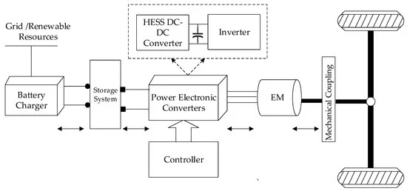
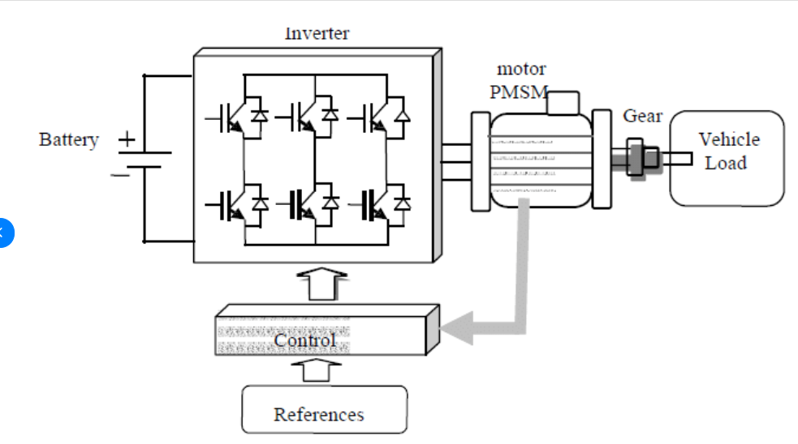
Ev Electric Motor Controller and Inverter Layouts Looks
Controller Design
Develop and implement motor control algorithms to achieve desired performance objectives such as smooth acceleration, regenerative braking, torque vectoring, and energy efficiency. This may involve designing proportional-integral-derivative (PID) controllers, flux estimators, and current regulators tailored to the motor and inverter characteristics.
Inverter Layout
The layout of an inverter in an electric vehicle (EV) system involves the physical arrangement of components and interconnections necessary to convert DC power from the battery into AC power to drive the electric motor

Slide 9
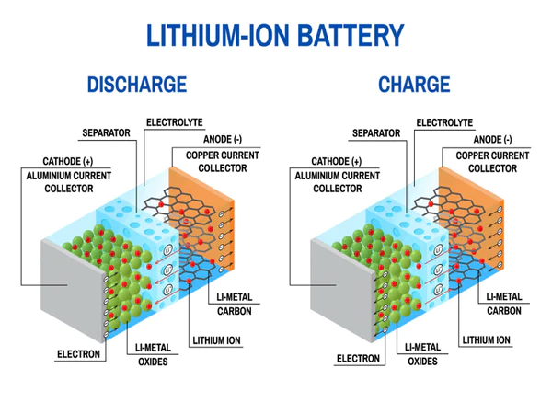
Battery Technology for Electric Vehicle
Electric vehicles (EVs) rely on advanced battery technology to store and deliver electrical energy for propulsion. Several types of batteries are used in electric vehicles, each with its own advantages and limitations.
Lithium-ion (Li-ion) Batteries: Lithium-ion batteries are the most common type of battery used in electric vehicles today. They offer high energy density, which means they can store a large amount of energy in a relatively small and lightweight package. Li-ion batteries also have good power density, allowing them to deliver high power output when needed.

Slide 10
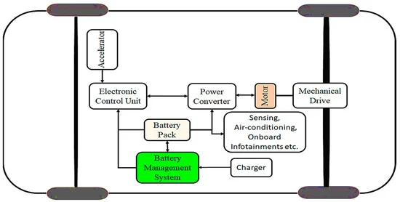
Battery Management
A Battery Management System (BMS) is a critical component in electric vehicles (EVs) and other battery-powered systems. Its primary function is to monitor and manage the performance, health, and safety of the battery pack.
Cell Monitoring:
State of Charge (SoC) Estimation
State of Health (SoH) Monitoring
Temperature Management
Cell Balancing
Safety Protections

Slide 11
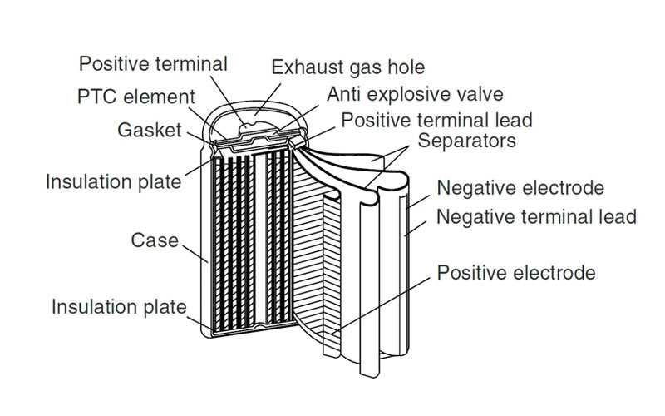
Lithium-ion battery pack manufacturing-cylindrical cell
Manufacturing lithium-ion battery packs using cylindrical cells involves several key steps and processes to ensure the production of high-quality and reliable battery systems.
Cell Selection
Cell Sorting and Grading
Cell Preparation
Cell Interconnection.
Module Assembly
Battery Management System (BMS) Integration
Thermal Management
Enclosure and Packaging
Testing and Quality Assurance
Final Inspection and Packaging

Slide 12
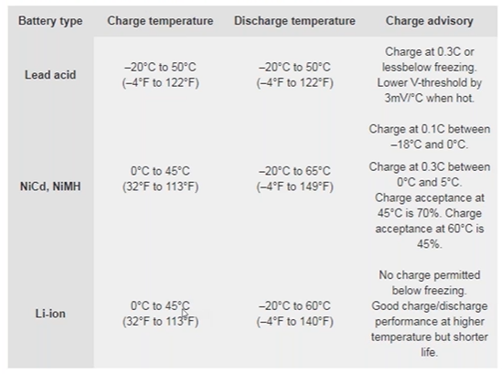
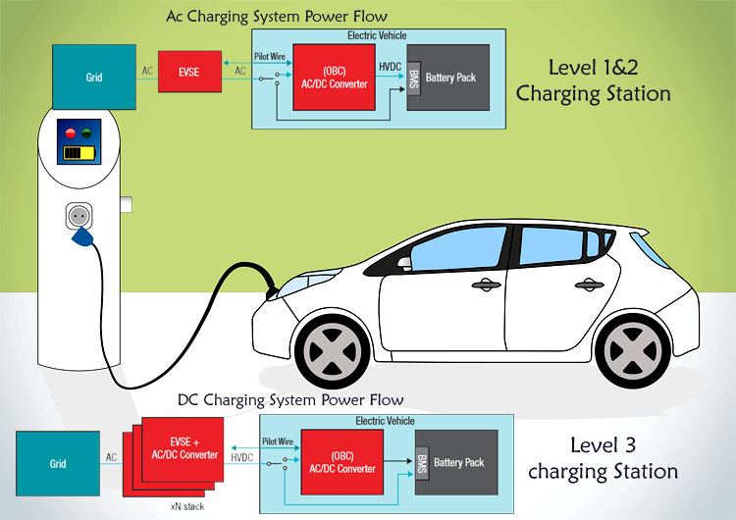
Charging System Design Considerations
Designing a charging system for electric vehicles involves several key considerations to ensure efficient, safe, and reliable charging operations. Here are some important design considerations for a charging system:
Voltage and Current Ratings
Charging Speed and Efficiency
Charging Connector and Standards
Safety Features
User Interface and Controls

Slide 13
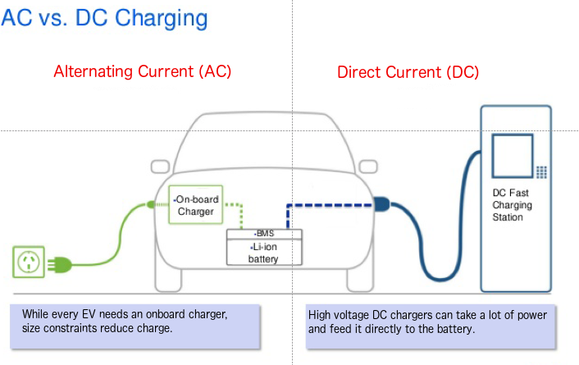
AC and DC Charging
AC (alternating current) and DC (direct current) charging are two common methods used to charge electric vehicles (EVs), each with its own characteristics and applications:
AC Charging:
AC charging involves converting AC power from the grid into DC power suitable for charging the vehicle's battery.
AC charging is typically slower compared to DC charging but is suitable for overnight or longer-duration charging sessions, such as at home or workplaces.
AC charging stations are often found in residential areas, parking lots, and commercial buildings.
DC Charging:
DC charging involves delivering high-voltage DC power directly to the vehicle's battery, bypassing the vehicle's onboard charger.
DC charging is much faster than AC charging and is suitable for rapid charging sessions, such as during long-distance travel or quick stops.
DC charging stations are often located along highways, major routes, and service stations to facilitate long-distance travel and reduce charging time.

Slide 14
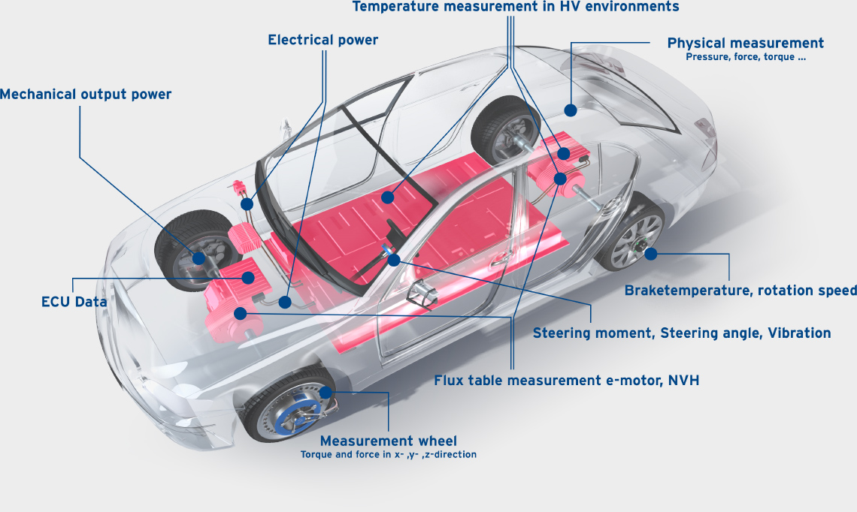
Testing of Electric Vehicles
Testing of electric vehicles (EVs) encompasses a range of procedures and assessments to ensure their safety, performance, durability, and compliance with regulatory standards.
Safety Testing
Performance Testing
Durability and Reliability Testing
Regulatory Compliance
Energy Efficiency Testing
Vehicle Dynamics and Handling
Software and Connectivity Testing

Slide 15
Questions ?

